Slide 1
Automatic Dog Door Elick Coval

Slide 2
Components
Raspberry Pi
Arduino
RFID tags and sensor
Laser proximity sensor

Slide 3
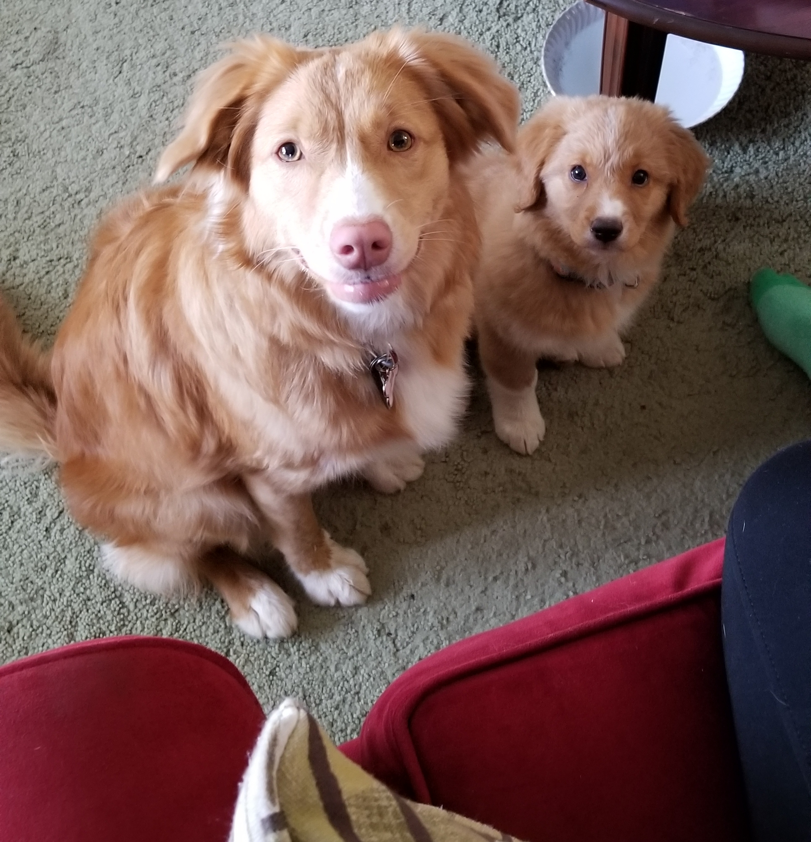
Demo participants
(Luna and Kipley)
Dog will have RFID tag on collar

Slide 4
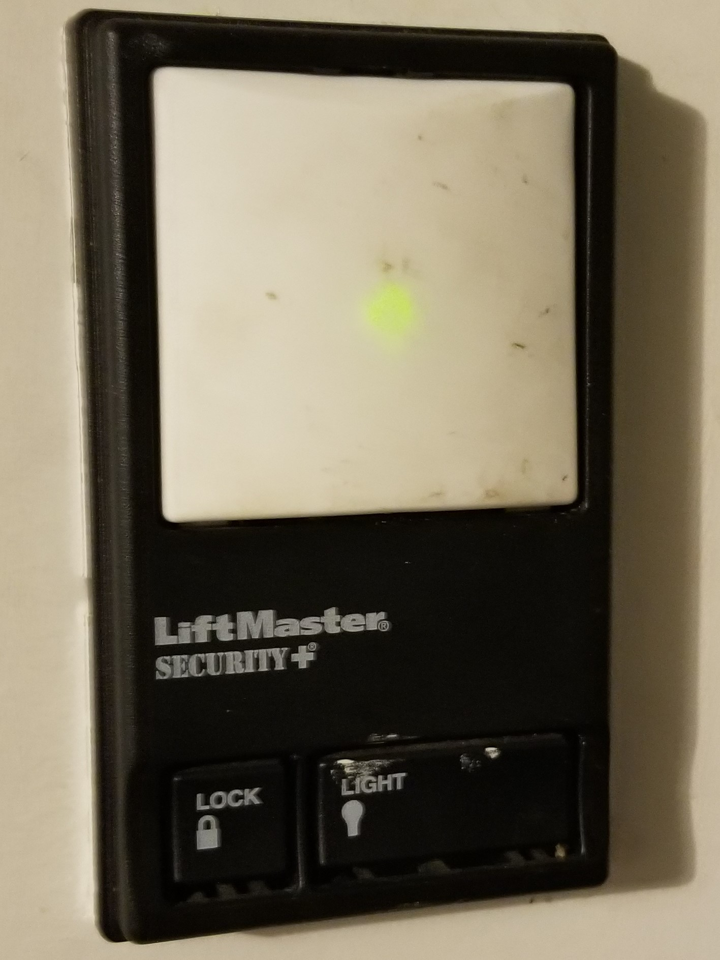
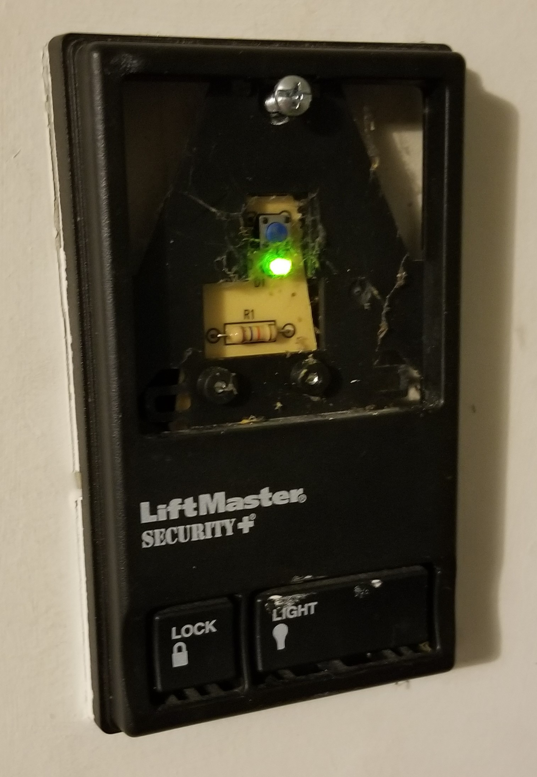
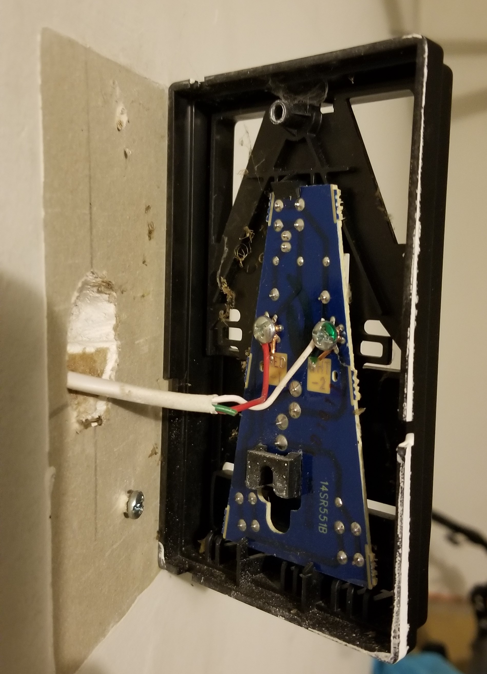
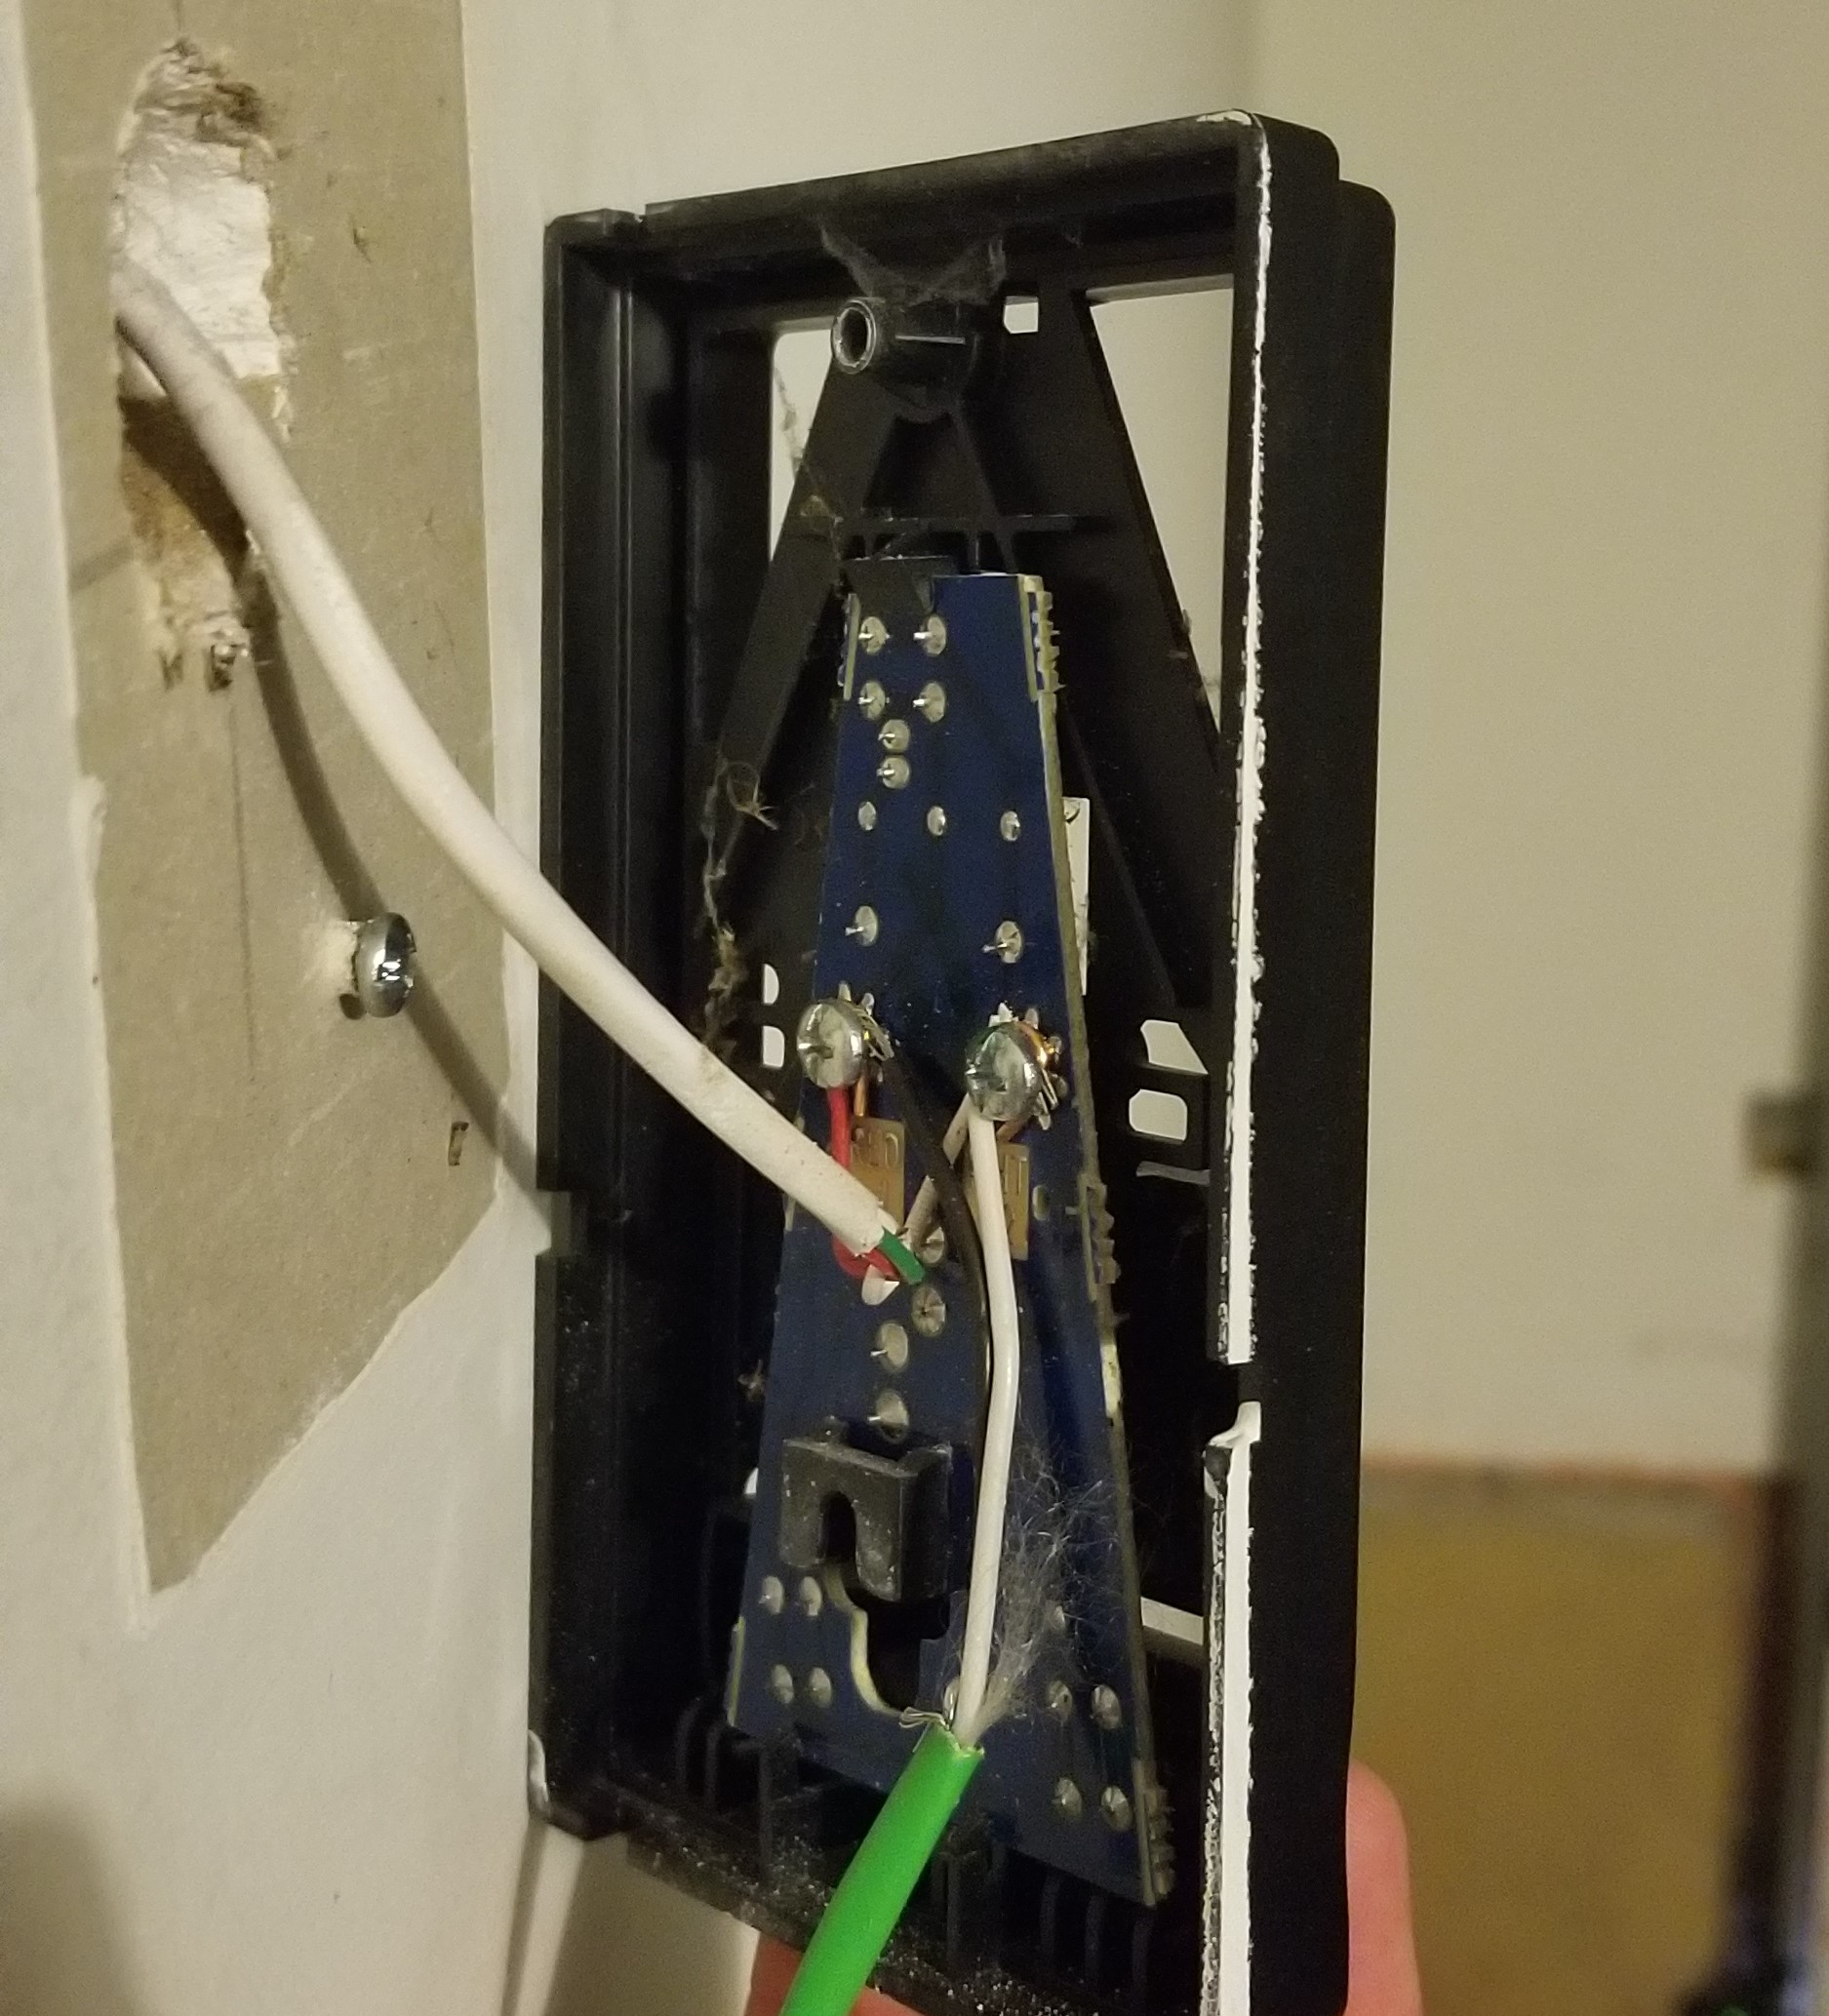
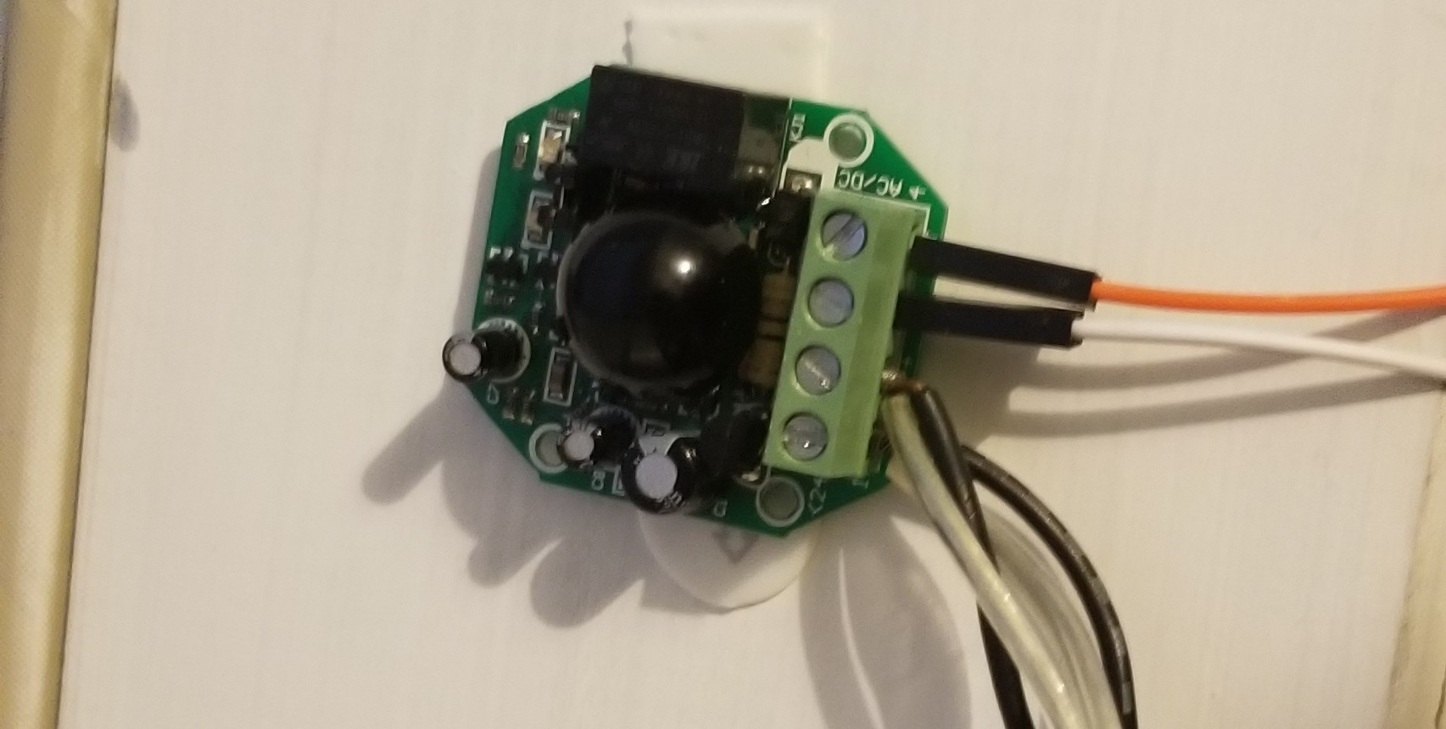
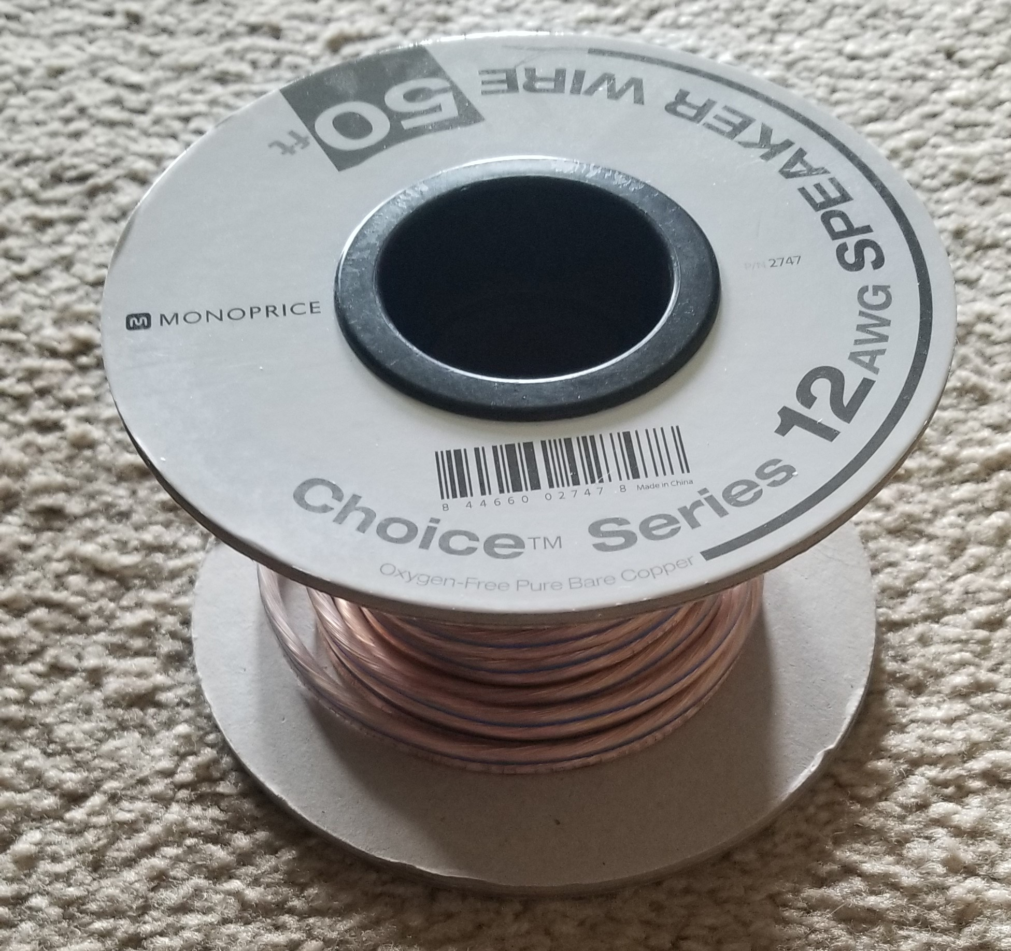
Preparation
Connect relay to garage door opener
Extend proximity sensor wire length to fit doorway

Slide 5

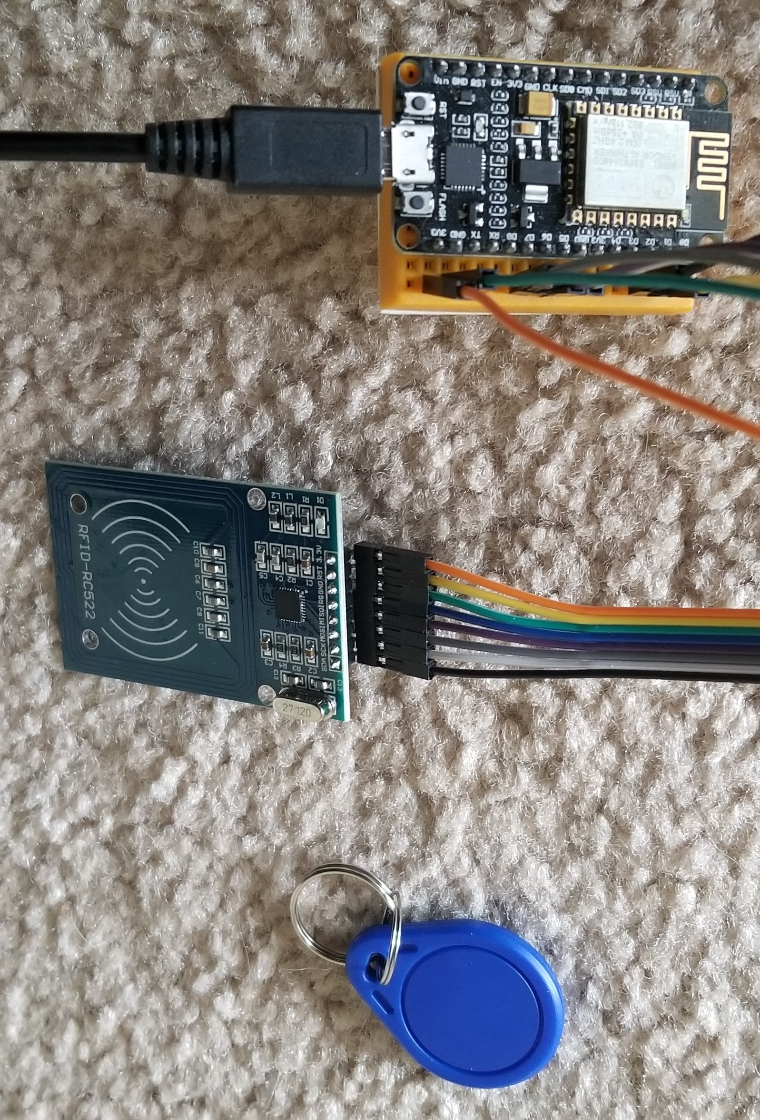
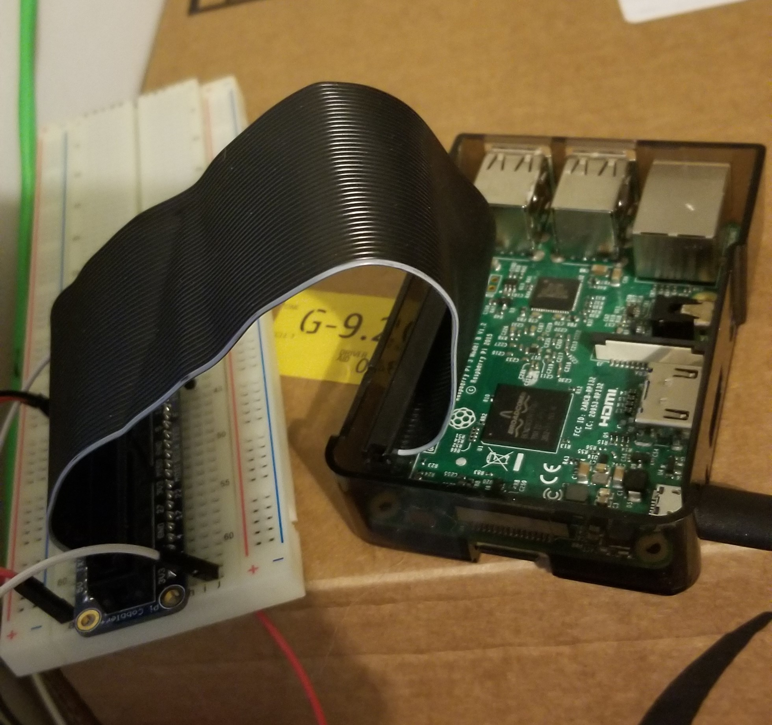
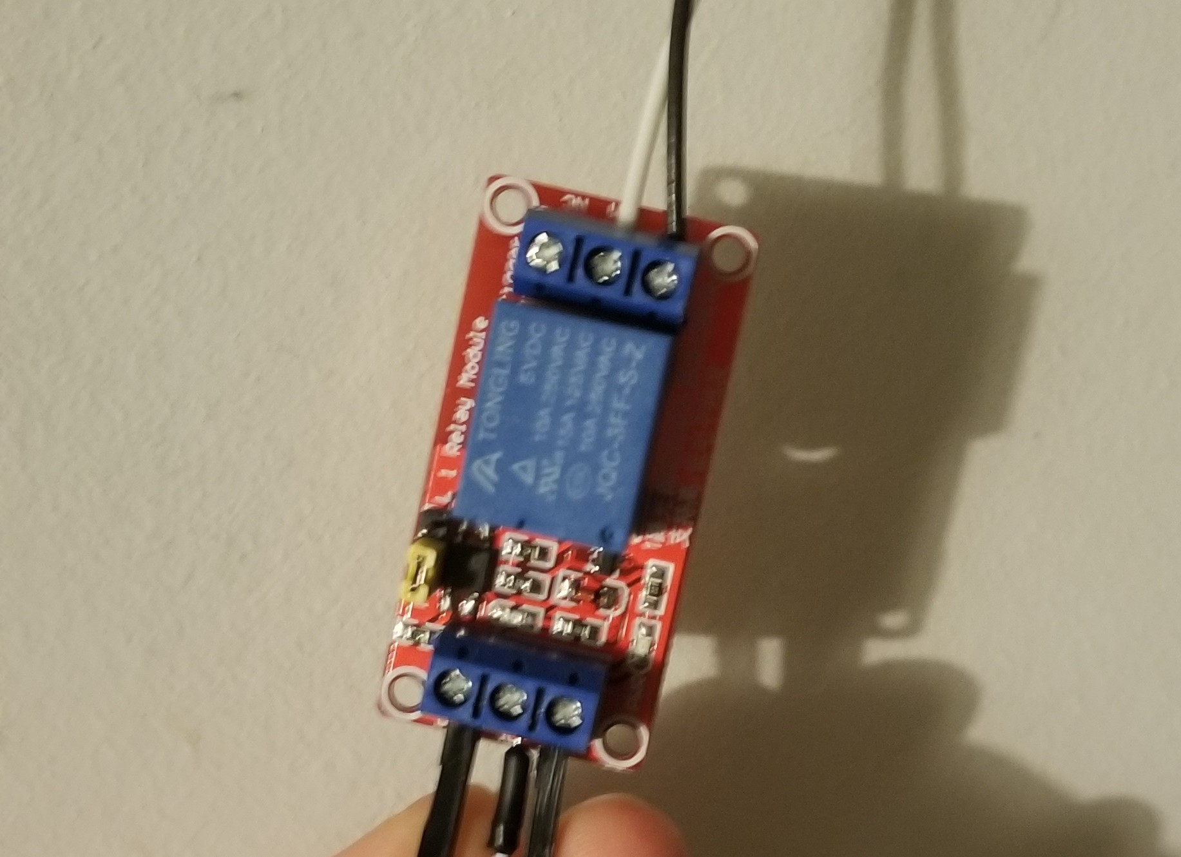


Simulate button push
Open door
RFID
Pi
Relay
(MQTT)
(wired)
(wired)
(wired)
Going Out
Coming In
(wired)
(wired)
(wired)
(wired)
Relay
Proximity Sensor
Close door
Simulate button push
Pi

Slide 6
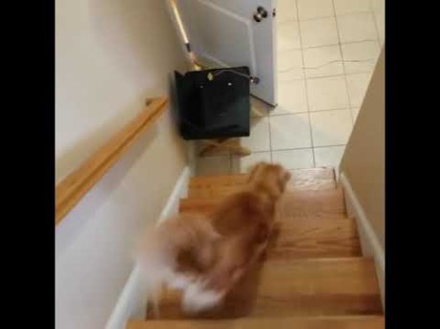
Video of components / Demo

Slide 7
Thanks for your time

